Slide 1



Effective Visualization Techniques COVID-19 Dataset
Webinar
June 21 – 10 to 12 PM
Dinesh Kumar P
Technical Product Manager
Notes:
A very good morning to one and all attending this webinar. Especially HOD - Dr. A. Murugan and Mrs. Jayapradha, for providing this opportunity to share my knowledge about Data Visualization.

Slide 2
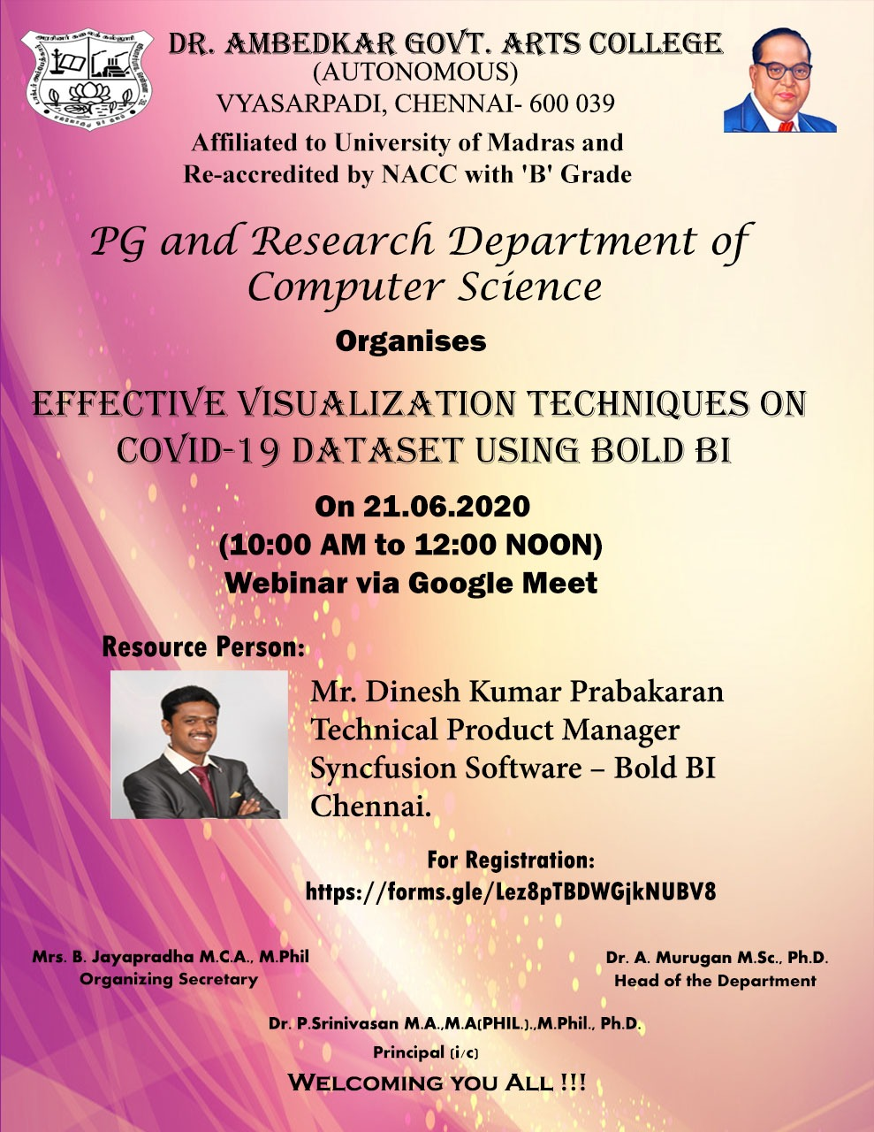
Notes:
A very good morning to one and all attending this webinar. Especially HOD - Dr. A. Murugan and Mrs. Jayapradha, for providing this opportunity to share my knowledge about Data Visualization.

Slide 3

For what quality, people get different pays for their job?
$ 1,00,000
$ 70,000
$ 50,000
$25,000
Notes:
Let me ask a simple question. For what basic skill, different people get different salary? Perhaps that is the same basic thing which all the ML or AI projects are solving and make our life easier.

Slide 4



Decision Making
Notes:
Its DECISION MAKING. And that’s what AI is doing for Humans right? I can say many real time examples for this. For now, lets take - the Google Maps. Before 5 years, if you are riding to a destination for which you don’t know the route, you will constantly ask the persons who are on your path way, think over the route and go on. But now, Google Maps in our mobile phone, decides and tells this is the right route. And we are travelling just by looking into that Map path. Notice that here decision-making work is partially taken over by the software comparing to the same situation before 5 years.
Software are no more just software. As engineers, we are making them as intelligent agents and make them evolve as more human in nature. Simply say, future machines with software will slowly rise to the conscious level of humans even!

Slide 5
Every progress in a work Driven by decision making
Programmer decides,
If branch (or)
Switch statement
Business man decides,
More discount (or)
Kind words
Data Analyst decides,
Linear model (or)
Regression model

Slide 6
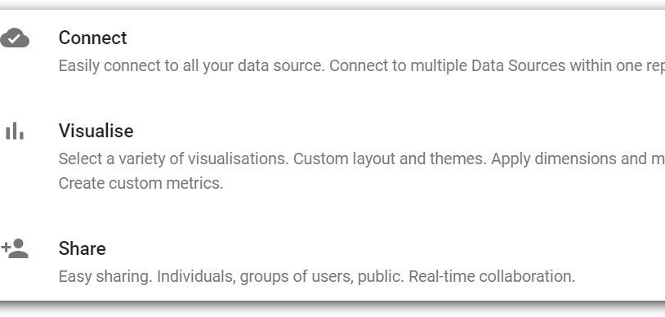
Notes:
Any BI tool will be addressing the following requirements:
It would enable connectivity in different business apps with ease along with security standards maintained during data transfers.
It would allow analyzing those data.
It would allow creating effective visuals easily and should be able to narrate the insights on its own.
The difference between different tools would be like, number of data source connections / number of charts / administrator features like user management / usability / cost factor / embedding and so on.

Slide 7
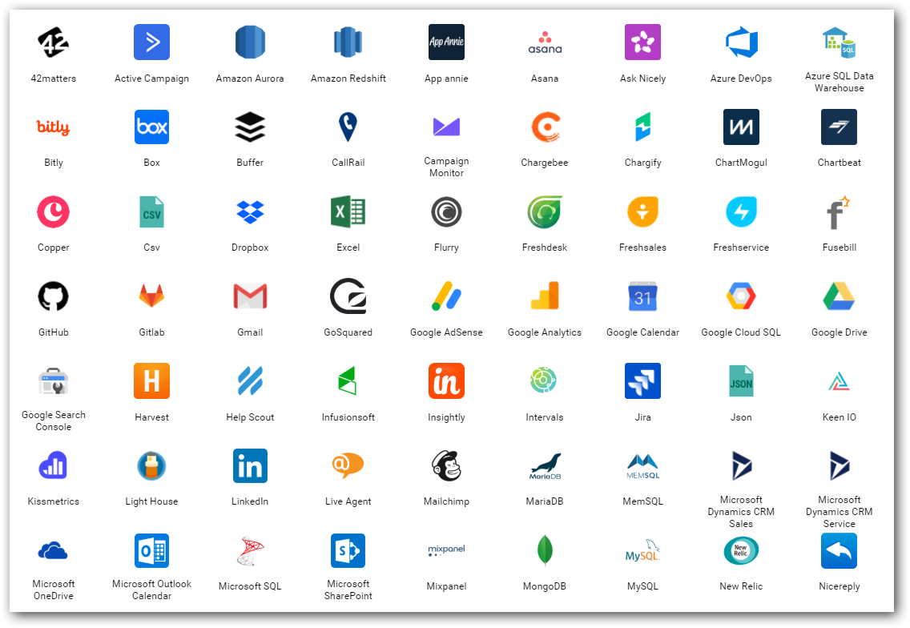
Data source(s)
Find out from where you need to get the data for your project.
Either provided or should search and find.
Logs
Databases
Web (REST APIs)
Social Media
…
Notes:
Logs – NASA logs which we gonna process.

Slide 8
SQL
Excel, Microsoft SQL, MySQL, PostgreSQL…
NoSQL
Format - Table with Rows and Columns.
Structured Data - RDBMS
CSV, JSON, AVRO, XML…
Format – Like Table, Parent/child, Nodes and edges…
Semi structured or no structure at all.
Notes:
Any BI tool will support either one of these 2 type of Data.

Slide 9
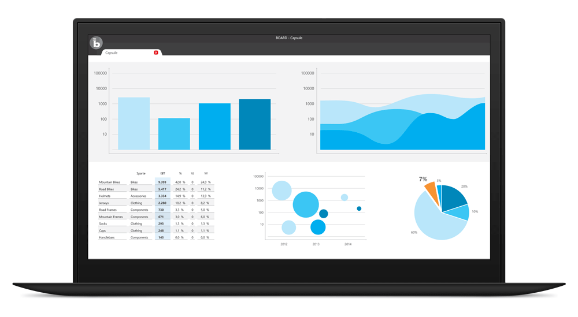
Visualize
BI tools for business decisions,
Microsoft Power BI
Tableau
Qlik
Bold BI
…
In-built packages in R, Python
Notes:
Most important.
This is how the top cream layer gets the view of their business that leads to decisions.

Slide 10
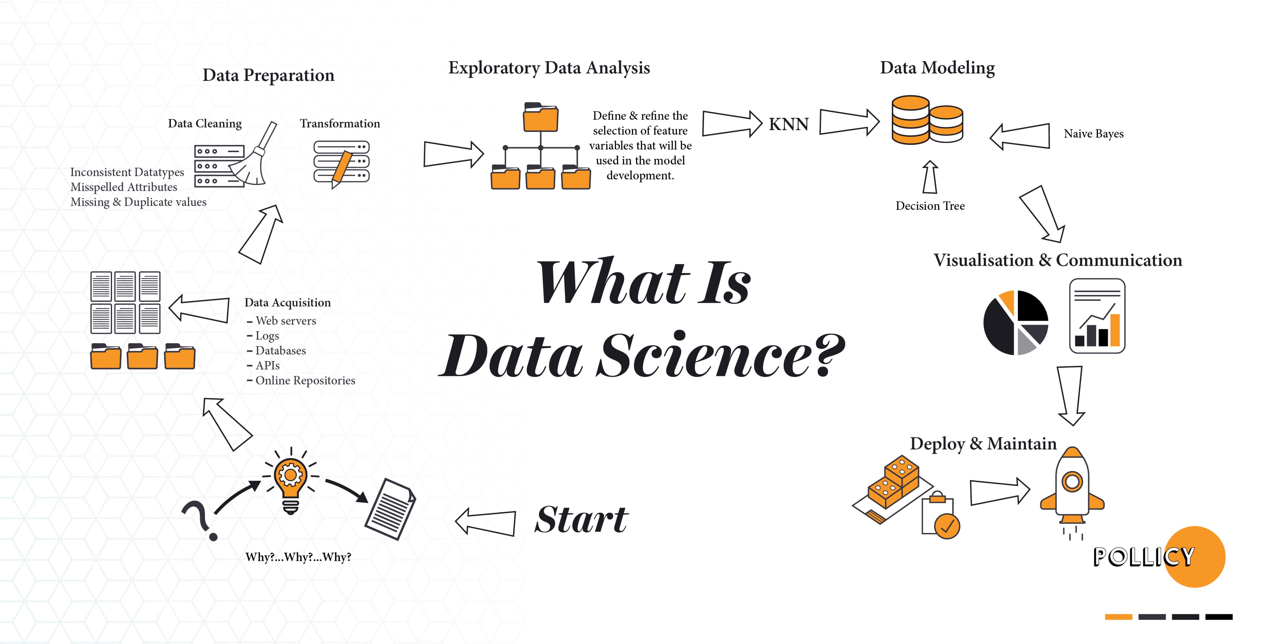
Notes:
I would say out of all, Visualization and Communication is most important process for a success of any project.

Slide 11

Importance of Business Intelligence and Visualization
How to convey your boss with data in Excel with thousands of rows?
Just convey it as a bar chart / pie chart.
Transform the data into charts, images,… that explain the numbers and allow us to get insights from it.
Meaning and purpose to the original data.
See the story that lives in your data.
Discover patterns (HISTORY), metrics (CURRENT) and spot trends (FUTURE).

Slide 12
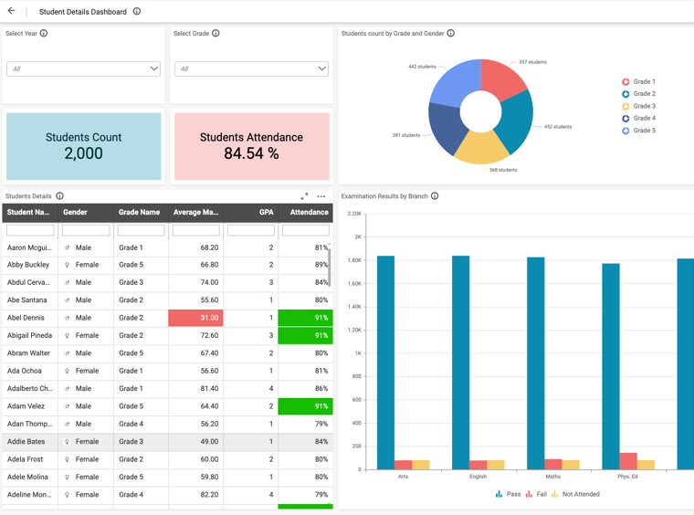
Sharing and Collaboration
User Management - Access control between users for Dashboard / Data source.
E.g. Currently we use.
Row level data security.
E.g. One Student Performance Analysis Dashboard for entire college;
Principal – Can see all departments.
Department head – Can see specific department alone.
Class Tutors – Can see specific class alone.

Slide 13
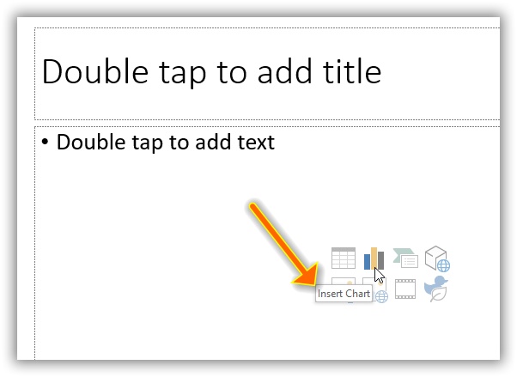
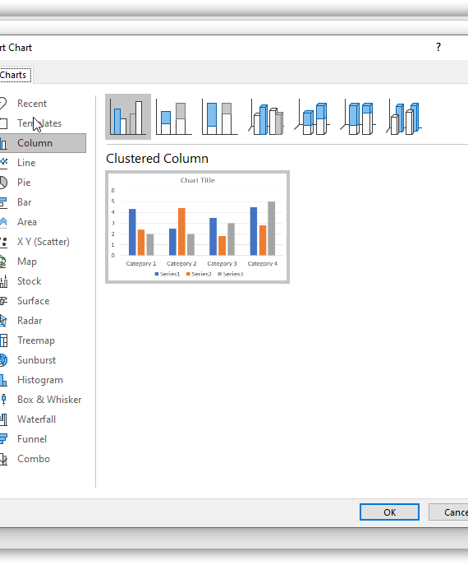
PowerPoint
Notes:
Visuals in PowerPoint. A miniature of Excel and Power BI into PowerPoint itself.

Slide 14
Semester score assessment
Notes:
Add a visualization by yourself. All you need to know is know the terms “Measure”, “Dimension” as clear as possible. Then you can simply differentiate your data and decide on best chart to apply on.

Slide 16
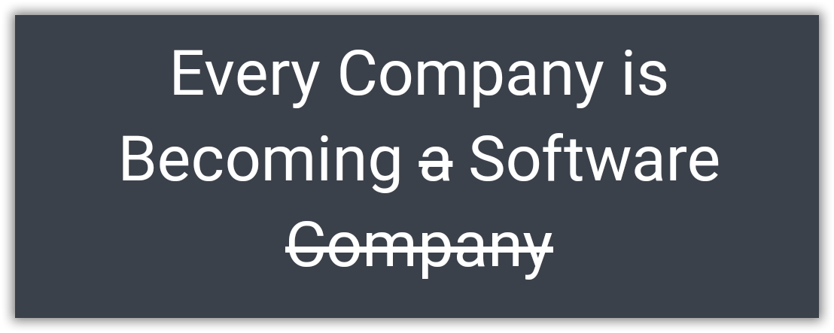
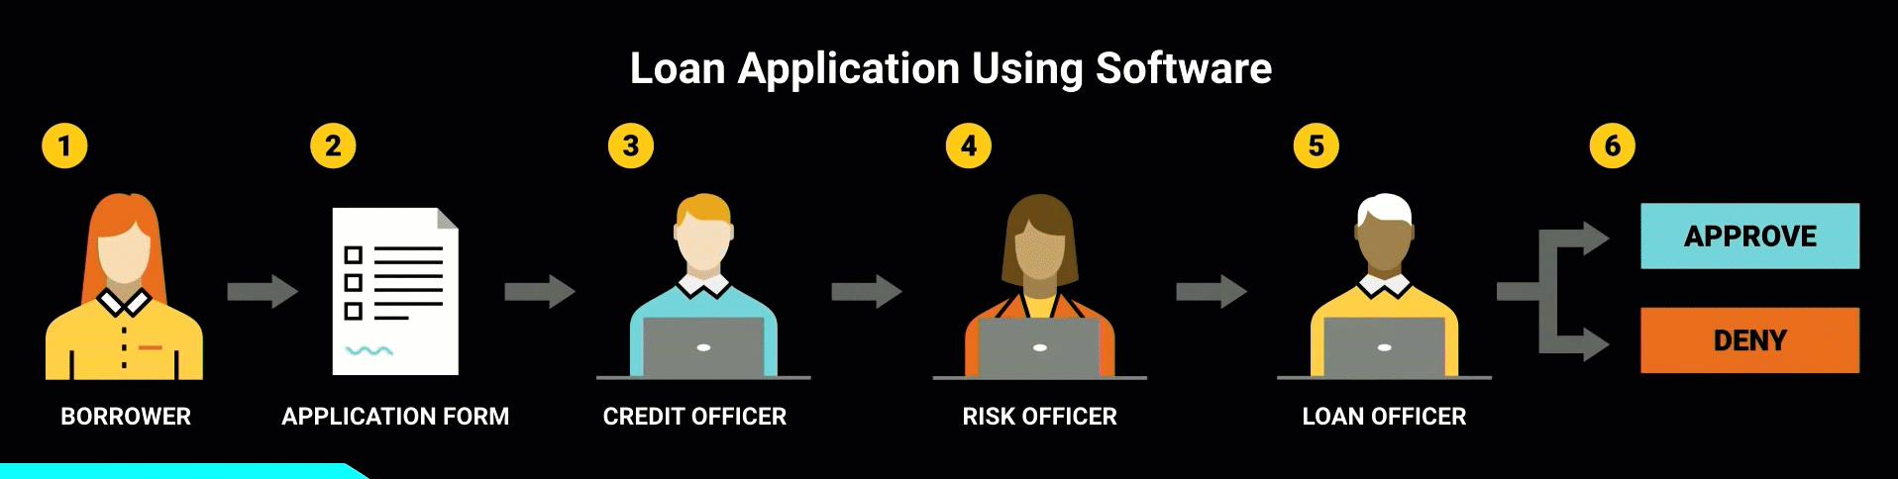
Borrowed from - https://www.youtube.com/watch?v=4QoCbhsQeyE
Notes:
Nowadays, if you take a bank,
Very old – Everything was done by humans.
A decade ago - Humans took decisions with the help of some software.
And now - by itself it has become almost as a complete software.
A perfect example would be of sanctioning a personal loan. Things like the CIBIL score, a person’s authenticity available as up-to-date data has provided the power to decide to sanction a loan to machines themselves.
Similar automation started to begin in Data Visualization as well.

Slide 17
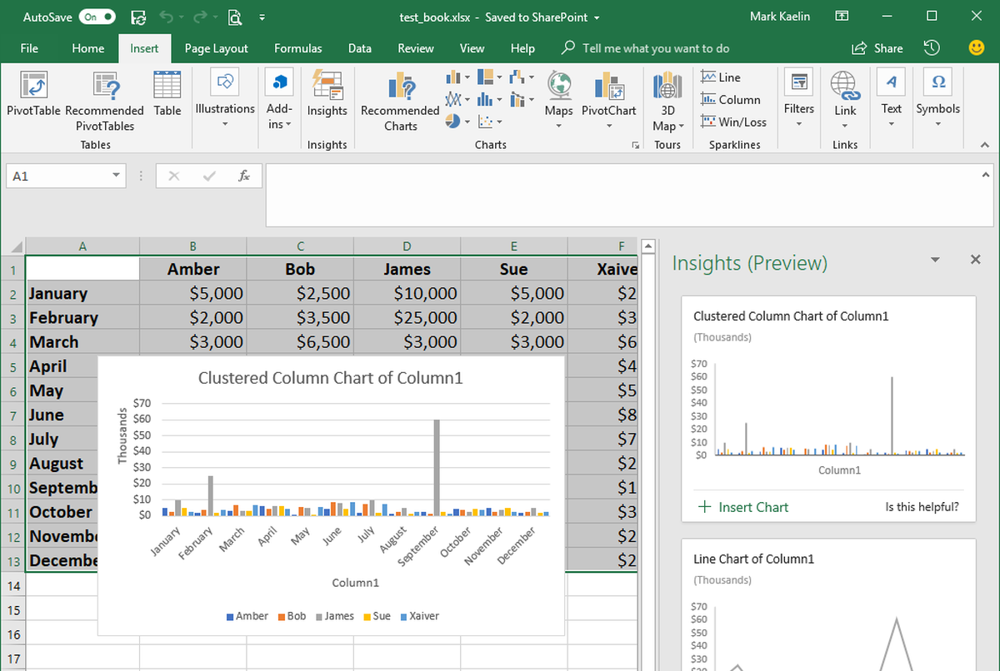
Excel
Notes:
Do we have anyone here know about or using “Ideas” in Excel?
Auto BI
Quickest and easiest way of Learning data analytics, visualization.
Works only with internet.
Demo
COVID-19 Data as Sheets, Dashboards, Story.
For Outliers – Show Energy Data as example. Excel Ideas also can help for Data Profiling to ensure the correctness of Excel data like there is no incorrect info like Outliers.

Slide 18

Break 5 minutes

Slide 19

Things to know before creating a dashboard

Slide 20
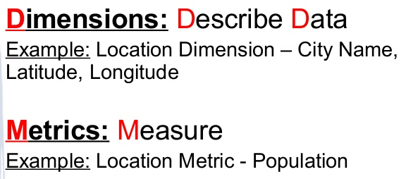
Dimensions vs Measures

Slide 21

Three things for effective visualization
Always audience in mind.
Clever in COLORS.
Use more Words.
June 2019
June 2020
Copyright © 2020 Syncfusion, Inc. All rights reserved.
Notes:
As mentioned in the first slide, effectively communicating the extracted insight to the target audience is important. These are 3 simple skills to improve the storytelling with data.
First and foremost is being specific about who your audience is. One should design everything keeping that audience in mind. Creating a chart for a communication purpose for our understanding is an easy task. If we step out of ourselves and think how do, we design for our audience will give effective results. Thinking is nothing but knowing ‘who are they’, ‘what do they care or expect’, ‘what keeps them up at night’.. Designing dashboards, keeping such motivation factors in mind will allow us to get their attention and can get our message across easily.
Next, coming to colors – It is not only about using pleasing colors in a dashboard. Think about where your audience to look and create a sparing contrast to achieve the attention.
Next, we should use more words in a dashboard. I mean it is words not sentences. Like axis labels, value labels, titles in a dashboard. Really these words will give more meaning quickly to the numbers and charts present in a dashboard.
https://visme.co/blog/dos-and-donts-chart-making/
https://infogram.com/blog/color-theory-dos-and-donts-for-data-visualization/

Slide 22
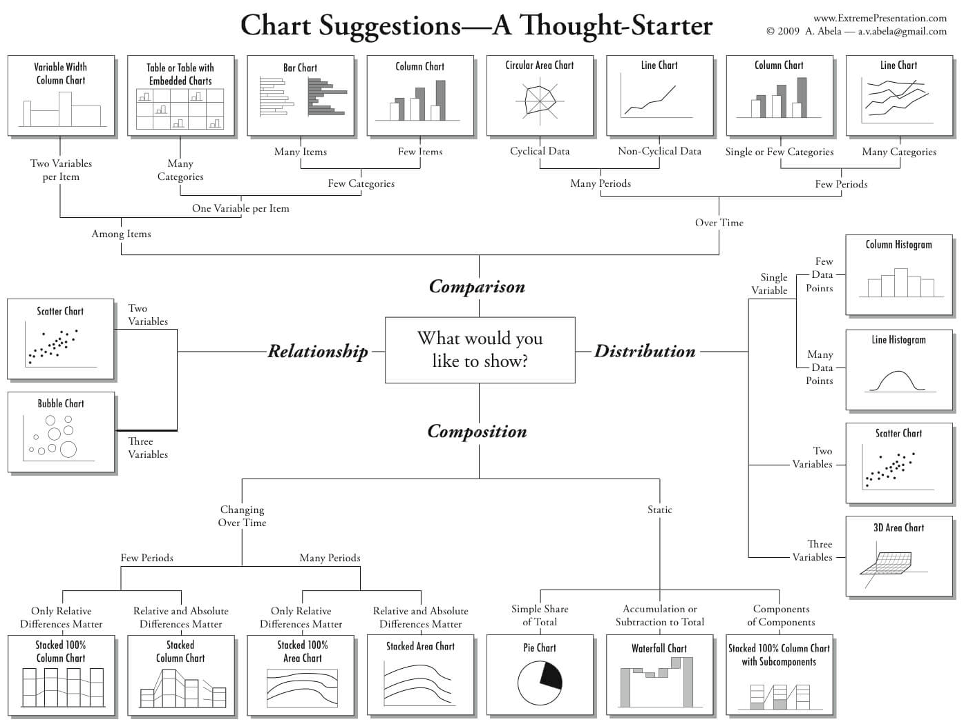
Notes:
This is like a rule book which most of us would be using while we get confused between choosing chart type.

Slide 23
Can you Answer?
Which one of the following is a Measure?
Sales Revenue
Sales Region
Sales Date
Notes:
Measures are numerical values that mathematical functions work on. Which one of the following is a Measure?

Slide 24
Can you Answer?
Which chart helps to find the relationship between data points?
Line Chart
Radial Gauge
Notes:
Which chart helps to find the relationship between data points?

Slide 25
Hands-on Deploy COVID-19 dashboard using Bold BI
Notes:
Goto data source page, create dashboard in COVID-19
Design 4 to 6 widgets including yesterday date.
Publish each dashboard by themselves. Mention that it will be available till a month time.
After the demo,
Finally explain 3 published dashboards and ask participants if any widget I should replicate.
https://demo.boldbi.com/bi/en-us/dashboards/5ac25fc1-d101-4aad-b435-ee53063ca4d7/Health%20Care/COVID-19?showmydashboards=1&tab=COVID-19%20-%20Global%20Analysis

Slide 26
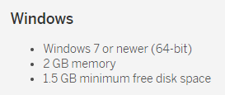
Tableau Public
https://public.tableau.com/en-us/s/
Notes:
Free to install and practice.
Only thing is you cannot save your workbooks in local.
Everything will be public including the data uploaded and dashboards created.
Demo – COVID-19 Data as Sheets, Dashboards, Story.

Slide 27
Can you Answer?
What is the new feature in Excel that does automatic data visualization?
Notes:
Ideas

Slide 28
Can you Answer?
Apart from Connect and Visualize, what is the 3rd important thing in a Business Intelligence tool?
Notes:
Share
Collaboration

Slide 29
Resources
Opensource tools
1. Tableau Public
2. Kibana
www.boldbi.com

Slide 30


Slide 31

Thank you! Questions ??

